Slide 1
Lab Safety and Equipment
21/02/2024
Year 7 Science

Slide 2
Learning Intentions
Conduct experiments safely,
using correct equipment

Slide 3
Success criteria
List safety rules
Label or draw equipment
Make scientific drawings

Slide 4
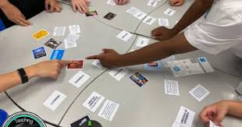

Lab Safety
Silent card shuffle:
Always Never

Slide 5
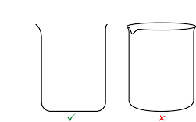
Laboratory Equipment
Draw in 2D

Slide 6
Science Equipment Treasure Hunt

Slide 7
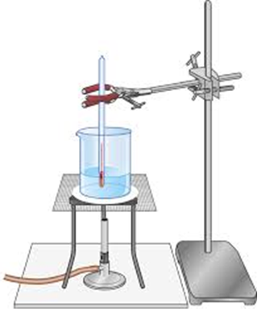
Laboratory Equipment

Slide 8
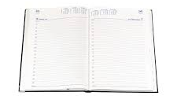
Diaries
Homework sheet – laboratory equipment
Due Thursday 8 Feb

Slide 9
Success criteria
List safety rules
Label or draw equipment
Make scientific drawings

